Slide 1
Case Studies

Slide 2
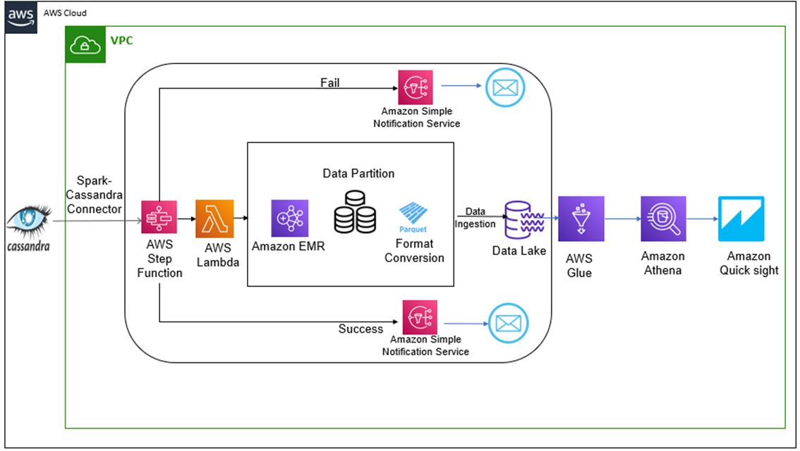
Case Study – Data Lake
The client uses trucks for the transportation of finished vehicles. These trucks have various sensors whose data is stored in Cassandra Database. Cassandra is efficient in write operations, but the OLAP requirements could not be met.
Challenges
Scaling the solution
The increasing variety of data
Long term storage, governance and query strategy
Easy and efficient reporting for adhoc analysis.
Cost-effective, should justify the ROI from the data analyzed.
Solution
Spark Cassandra Connector from Datastax used to access data form Cassandra DB using EMR on AWS
Lambda invokes EMR Cluster to trigger data ingestion job
Spark job written for data cleaning, transformation and conversion, data partitioned on data timestamp
Lake Formation used to set up and secure Data, Athena used for queries and Quicksight for visualization.
Benefits
90%
Improved analysis and query time
15%
Improved on-time shipment
20%
Cost saving

Slide 3
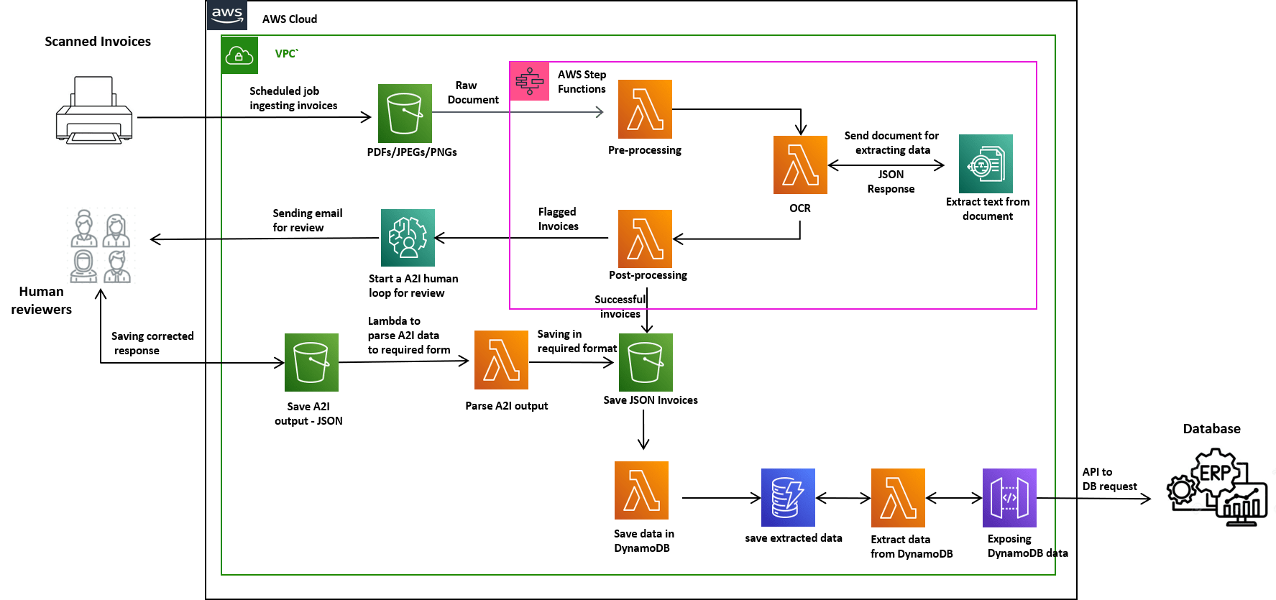
Case Study – Accelerated Document Processing
Client wanted to do the digitization of the invoices received from different vendors, primarily focused on the Header, Footer and Item Level Information. We received invoices in pdf format, had to extract the relevant information and store it to the database.
Challenges
Reduce the effect of noise for the processing of document.
Extracting the Key-pair values from raw file.
Matching different types of amount values in invoice
Parsing of Item level Information and converting to tabular format in JSON and ensuring every column is extracted.
Solution
Pre-Processed the raw pdf files to reduce the effect of noise including signature, seal and handwritten marks in pdf.
Did Post-Processing on the response to extract the relevant information like Header, Footer and Item Level Information in desired format like Json
Uploaded the final Json File to the S3 & saved into database also.
Benefits
40%
Human effort
5%
Increased information extraction
Reduced cycle time

Slide 4
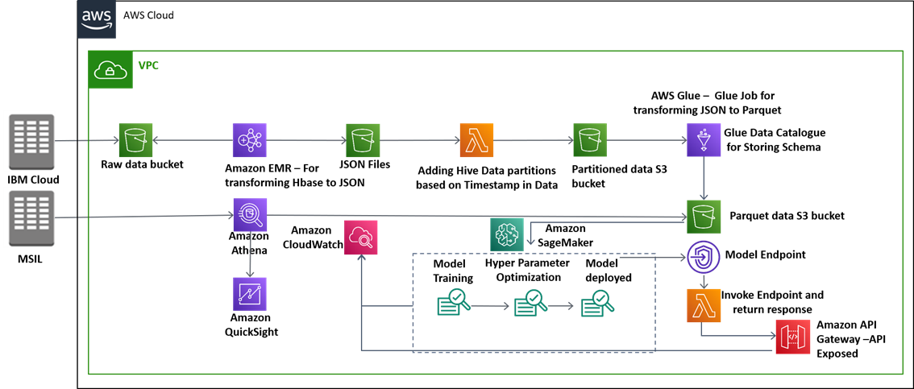

Case Study – Demand Forecasting
The client wanted to do demand forecasting of selected largest selling models leading to right production planning for these models as a result savings in inventory costs by their customer demand.
Challenges
Find the sales of the vehicles for the upcoming months.
Various leading economic indicators taken into account.
Data consolidation at different granularity levels – daily, monthly etc.
Past 3 years data for forecasting.
Solution
Final Tables contains detailed data about the invoice, we have scrapped economic indicators, competition and holidays data from Internet.
Data analyzed using multiple techniques, like exploratory data analysis, feature selection, dimensionality reduction, regression analysis, hyperparameter tuning. To match demand 37+ models were created
Benefits
93%
Accuracy of Forecasting Model
Reduced model training and deployment costs

Slide 5
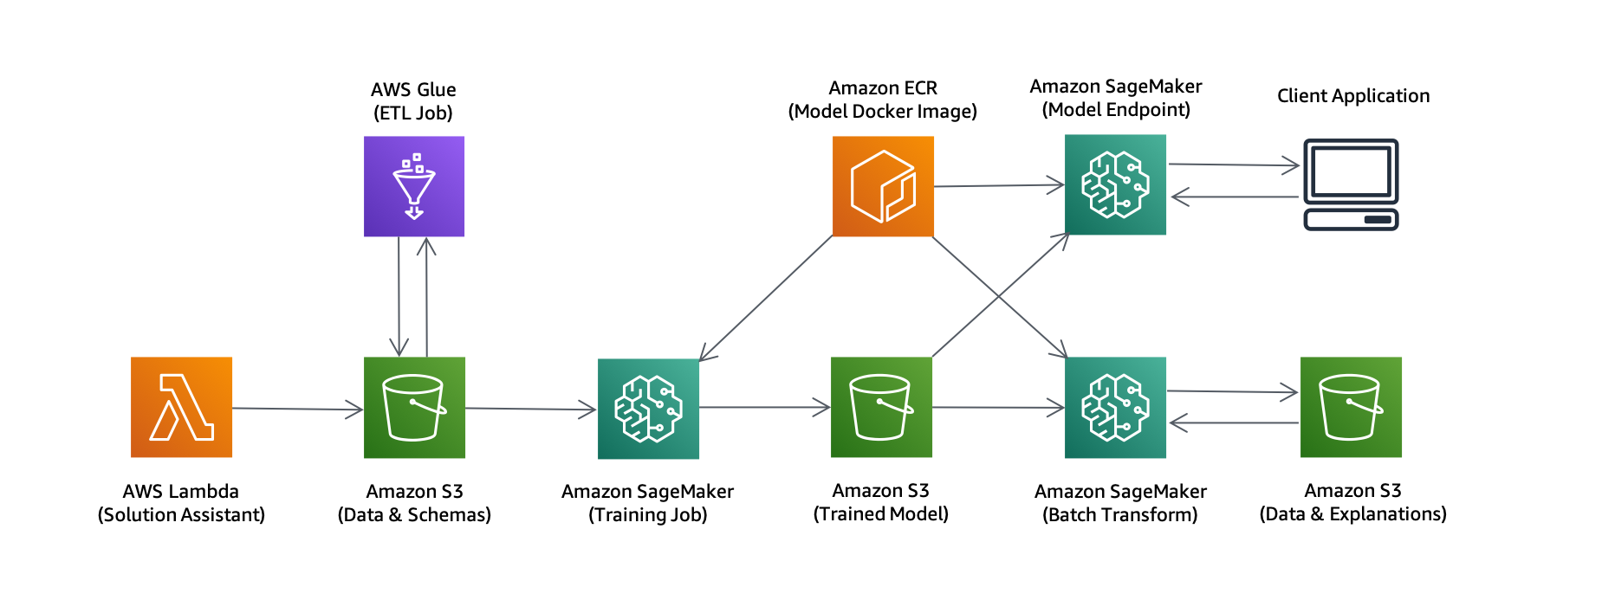
Case Study – Credit Scoring Model
Client had a credit application, the aim of the client is to predict whether or not the customer will pay back the credit in accordance with their repayment plan by finding out customer's credit score as denying trustworthy customers credit also has a set of negative impacts.
Challenges
Selection of input parameters is crucial for finance solution.
Increasing complexity of ML models, the need for model explainability has come up.
Some governments have introduced stricter regulations that mandate a right to explanation from ML models.
Solution
We classify credit applications and predict whether the credit would be paid back or not (often called a credit default).
We train a tree-based LightGBM model using Amazon SageMaker and do predictions using a game theoretic approach called SHAP (SHapley Additive exPlanations).
Ultimately, we deploy an endpoint that returns the model prediction and the associated explanation.
Benefits
40%
Reduction in manual referrals
84%
Increased credit worthiness
Reduced processing time

Slide 6
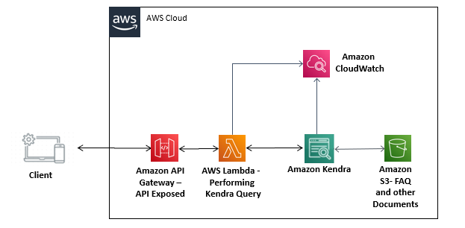
Case Study – Kendra NLP Search
Client wanted a Cognitive Search for contents of their website along with user-level restriction. The customer desires highly robust and cost-effective solution to retrieve relevant content using semantic search based on the concept of Natural Language processing (NLP),
Challenges
NLP based Cognitive Searching of the contents
User should be able to perform NLP based Searching based on the contents of Publications, Journals, Students FAQs, Members FAQs stored in Amazon S3
Enabling user level restriction for each category
Solution
Every Kendra index comprises of configuring the data sources that connect to the S3 buckets having ICAI document store.
Controlled access to documents in an S3 data source using a configuration file.
AWS Lambda for backend to call Kendra API’s along with AttributeFilters set to the user category, tagging further optimizes the fetched results.
Benefits
66%
Increased information extraction
Reduced category specific response time

Slide 7
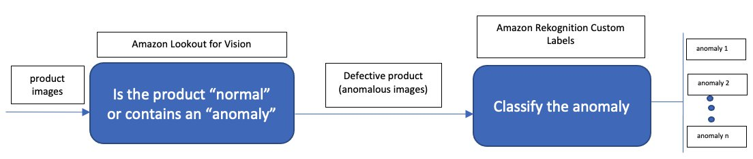
Case Study – Rekognition for Quality Inspection
The current method of defect detection is either in-line or end-of-line manual checks which is a time-consuming and expensive task. So, the Client wanted to detect damages to manufactured parts, identify missing parts, and process-related issues in manufacturing lines using ML.
Challenges
Identify suitable data augmentation techniques to increase the number and diversity of training datasets and improve Amazon Rekognition Custom Labels model performance.
Demonstrate that using the combination of Lookout and Rekognition Custom Labels has better model performance.
Solution
The first is preparing the dataset. Then, Lookout for Vision uses this dataset to automatically train the ML model that learns to detect anomalies in the product.
The model is started and the detect-anomalies API from Lookout for Vision is called and followed by Amazon Rekognition Custom Labels for defect classification . After detecting anomalies, the stop-model API is used.
Benefits
Increased industrial product quality
Reduced operational costs

Slide 8
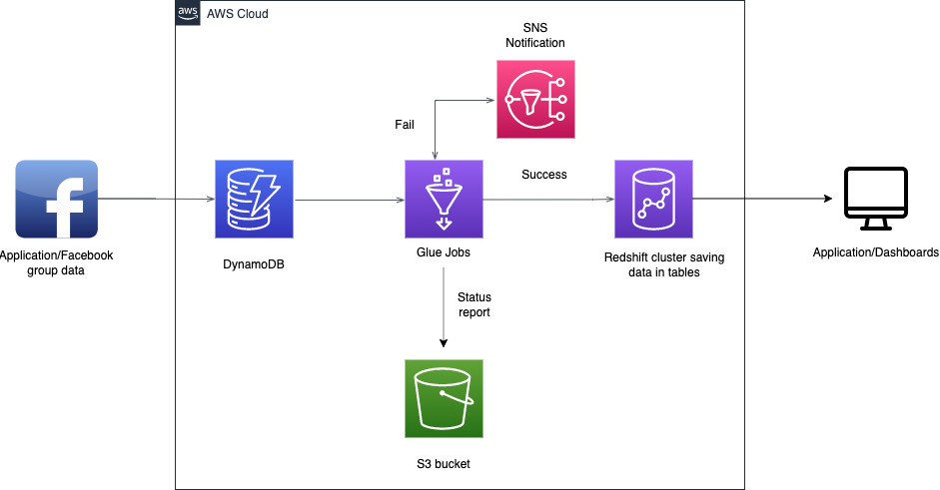
Case Study – Data Warehouse(Convosight)
Client wanted to have a robust, more secure and easily accessible and developer friendly system as it was growing in business. So, it wanted to bring all its existing external 3rd Party Services like Panoply to be migrated to cloud platforms like AWS(Amazon Web Services).
Challenges
Supporting complex data types like list-of-strings (Creation of sub tables for these lists)
Supporting schema changes (Addition of new columns at DynamoDB side)
Migration of heavy table(few tables are 30GB-40GB)
Solution
ETL solution is implemented where data is ingested from DynamoDB, transformed to suitable form(casting data types, breaking the complex data types) so that it can be written to Redshift.
This migration is a two-step process. The first step includes total migration of data up to date. The second step involves incremental data migration which runs multiple times a day.
Benefits
20%
Reduction in overheads and cost
30%
Reduction in Overall Processing time
Notes:
30% Reduction in Overall Processing time as compared to Panoply
20% Reduction in overheads and cost due to no fixed licensing cost as compared to Panoply Solution
Data remains in a same AWS region and hence more secure as compared to Panoply Solution

Slide 9
Offerings

Slide 10
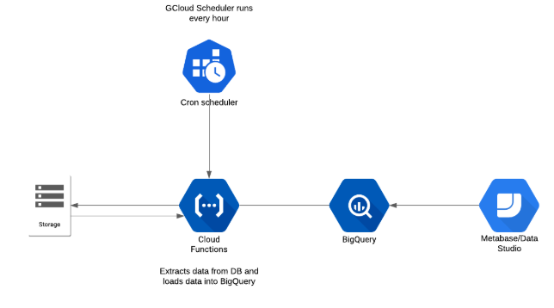

Data Lake / ETL
A data lake is a centralized repository designed to store, process, and secure large amounts of structured, semistructured, and unstructured data.
Extract, transform, and load (ETL) is a data pipeline used to collect data from various sources. It then transforms the data according to business rules, and it loads the data into a destination data store.
Key Advantages

Slide 11
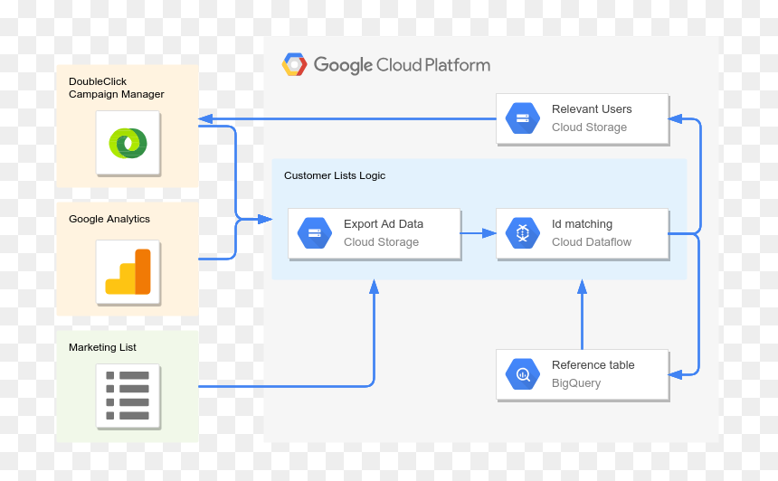
Data Warehousing
A data lake is a centralized repository designed to store, process, and secure large amounts of structured, semistructured, and unstructured data.
Extract, transform, and load (ETL) is a data pipeline used to collect data from various sources. It then transforms the data according to business rules, and it loads the data into a destination data store.
Key Advantages

Slide 12
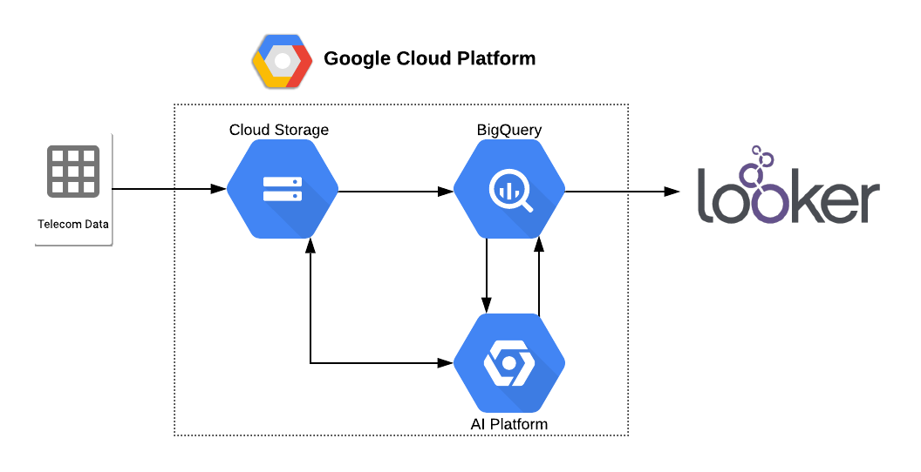
BI - Visualization Dashboards
Business intelligence dashboards are information management and data visualization solutions used to analyze your data.
Key Advantages

Slide 13
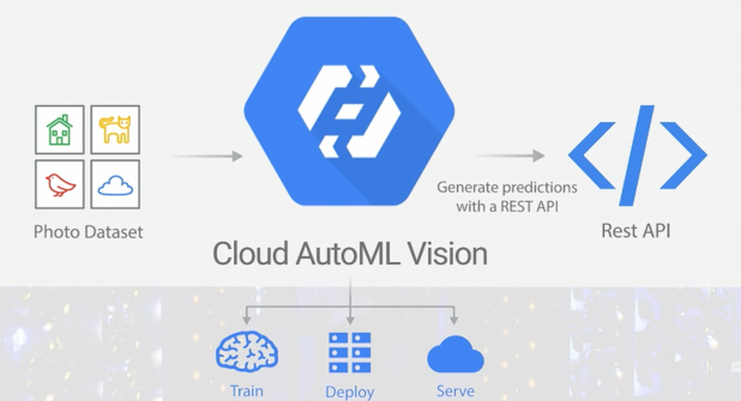
ML Models
A machine learning model is trained to recognize certain types of patterns. We train a model over a set of data, providing it an algorithm that it can use to reason over and learn from those data.
Key Advantages

Slide 14
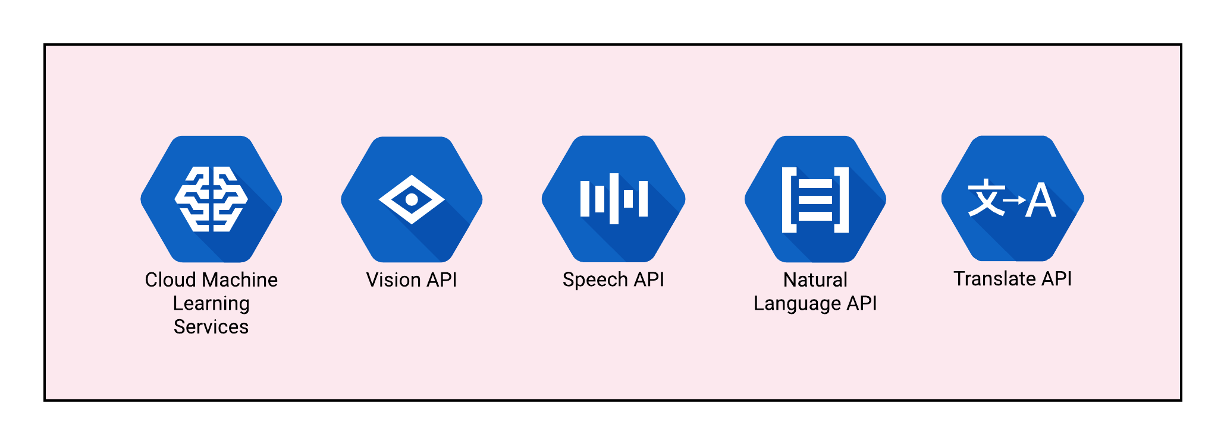
AI Services
AI Services is a collection of services with prebuilt machine learning models that make it easier for developers to apply AI to applications and business operations.
Key Advantages

Slide 15
AIOps
AIOps combines big data and machine learning to automate IT operations processes, including event correlation, anomaly detection and causality determination.
Key Advantages

Slide 16
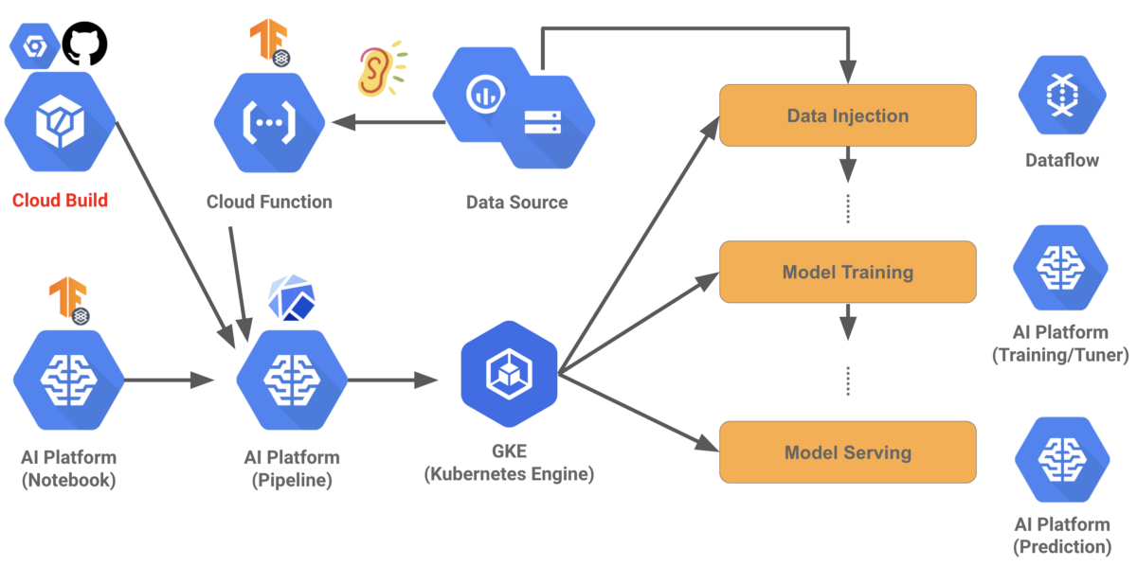
MLOps
MLOps is an ML engineering culture and practice that aims at unifying ML system development (Dev) and ML system operation (Ops). In this, we advocate for automation and monitoring at all steps of ML system construction, including integration, testing, releasing, deployment and infrastructure management.
Key Advantages

